Slide 1

TAKENMIND GLOBAL DATA ANALYTICS INTERNSHIP
PROOF OF CONCEPT ATTRITION CONTROL PROJECT

Slide 2
TAKENMIND GLOBAL DATA ANALYTICS INTERNSHIP
NAME : DEBORAH ALENKHE
COUNTRY: NIGERIA
EMAIL : debbalen@yahoo.com
PROJECT TITLE : ATTRITION CONTROL

Slide 3
SOLUTION METHODOLOGY
OBJECTIVE: Presenting an analytical solution to help a company which is trying to control attrition by answering the following questions;
1. What type of employees are leaving ?
2. Which employees are prone to leave next?
Using data analytics to generate meaningful insights and present these insights inform of visualizations from the available data provided by the company. The following analytical techniques were implemented;
STEP 1: UNDERSTANDING THE VARIOUS FEATURES OF THE DATASET AND WHICH FEATURES ARE OF IMPORTANCE TO THE OBJECTIVE OF OUR ANALYSIS

Slide 4
SOLUTION METHODOLOGY
STEP 2: UNIVARIATE ANALYSIS STEP 3: BI/MULTIVARIATE ANALYSIS
An Analysis of individual information of Employees who left the company
An Analysis of individual information of Existing Employees
The visualized output of both analysis are compared to draw out trends and insights
An Analysis of 2 or more information of Employees who left the company
An Analysis of 2 or more information of Existing Employees
The visualized output of both analysis are compared to draw out trends and insights

Slide 5
Solution METHODOLOGY
STEP 3: INSIGHTS, OBSERVATION AND RECOMMENDATIONS OF THE OBJECTIVE OF THE COMPANY.
The displayed and visualized outputs of step 2 and step 3 provide hidden insights inform of which helps the company solve and control the attrition challenge faced by the company.

Slide 6
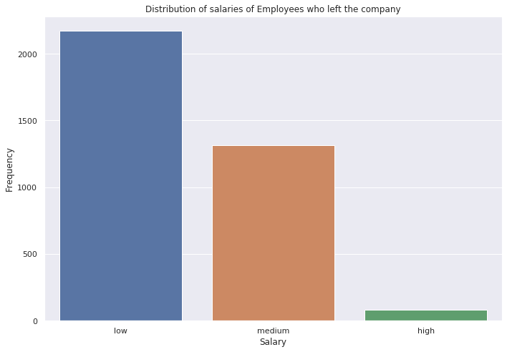
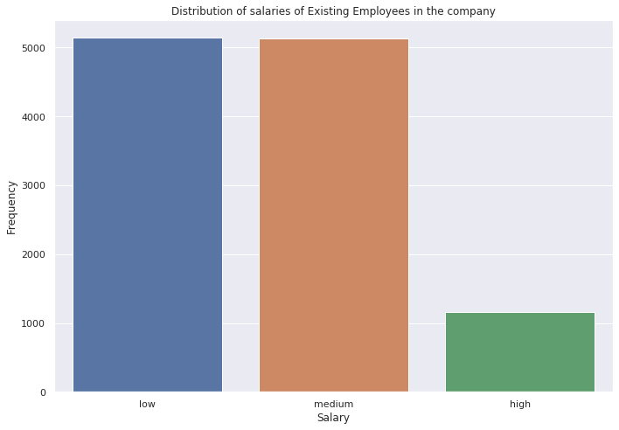
VISUALIZATION OF METHODOLOGY
STEP 2: UNIVARIATE ANALYSIS
This stage entails analysing each important feature of the dataset
CHART 1

Slide 7
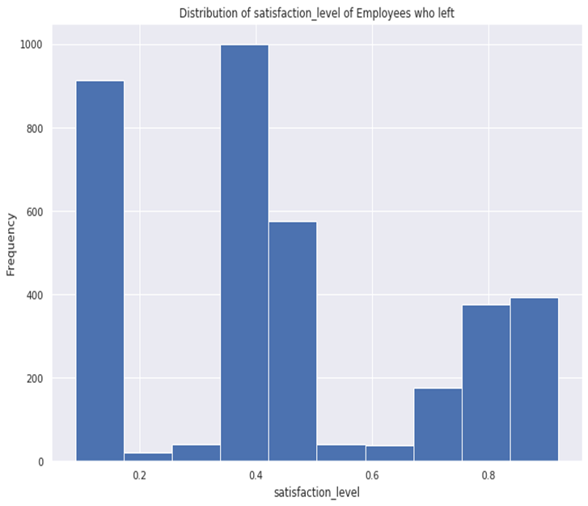
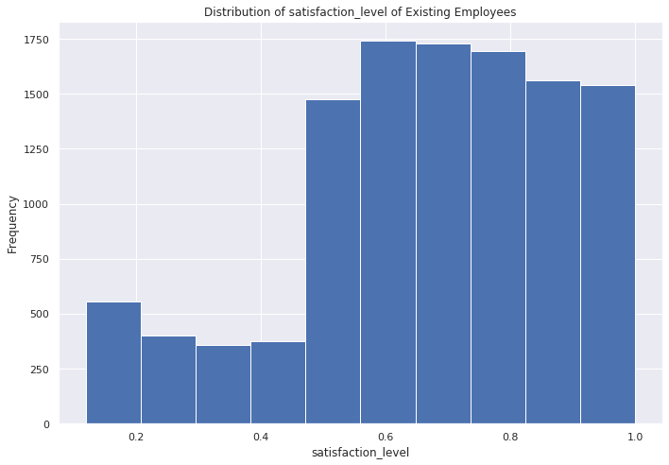
VISUALIZATION METHODOLOGY
CHART 2

Slide 8
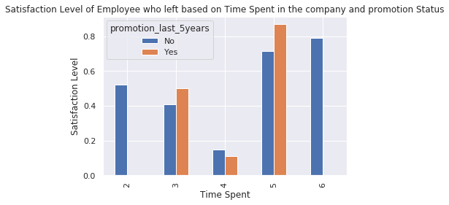
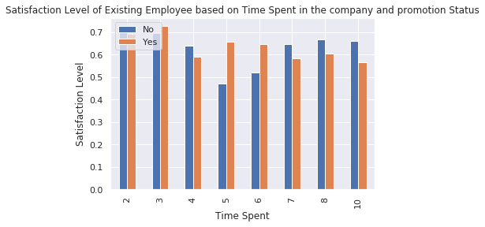
VISUALIZATION METHODOLOGY
STEP 3: BI/MULTIVARIATE ANALYSIS
This step involves analysing multiple features of information of the dataset, generating insights.
CHART 3

Slide 9
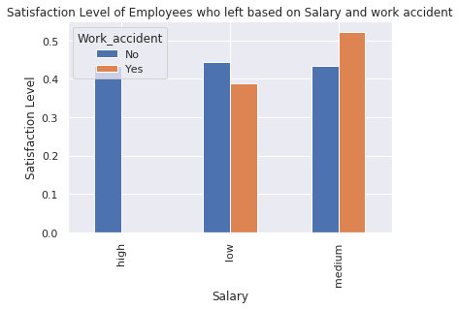
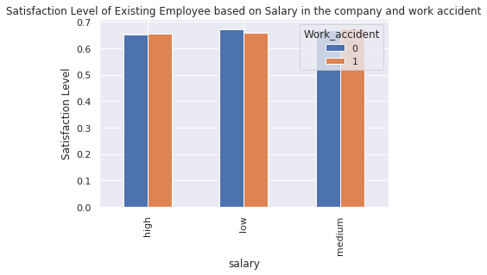
VISUALIZATION METHODOLOGY
CHART 4

Slide 10
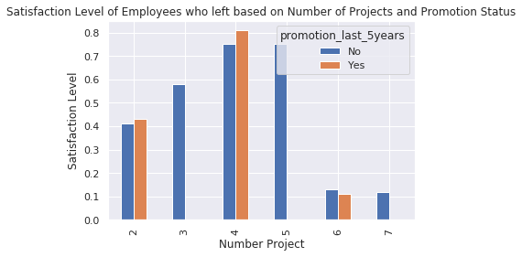
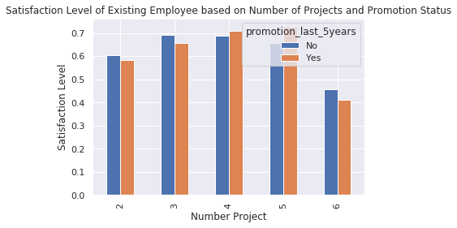
VISUALIZATION METHODOLOGY
CHART 5

Slide 11
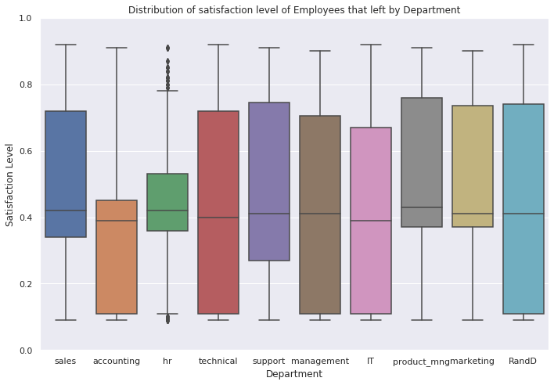
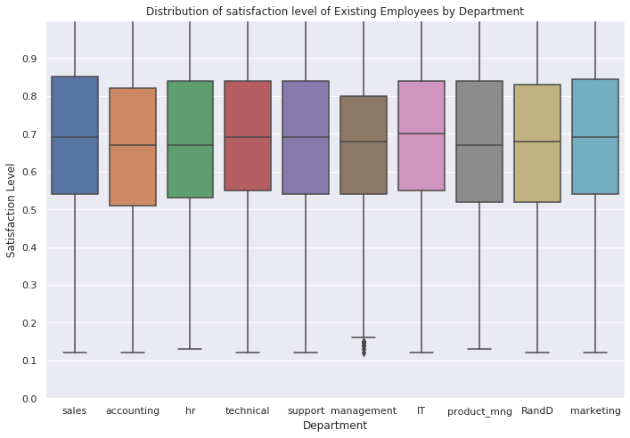
VISUALIZATION METHODOLOGY
CHART 5

Slide 12

STEP 3: INSIGHTS, OBSERVATIONS AND RECOMMENDATIONS
After examining the data of Employees existing and those who left the company concurrently, the following insights and observations were found.
From Chart 2, the average satisfaction level of employees who left was below average of 45% while existing employees was around 70%, further analysis were carried out and it was discovered that about 65% of employees who left had a satisfaction level below 45%. Diving deeper into why employees who left had a low satisfaction level, it was discovered that 99.6% of them where not promoted within the last 5 years.
Hence a major factor as to why employees are leaving is due to low satisfaction level and no promotion within the last 5 years of working for the company.
From the insight derived from satisfaction level of employees who left its imperative we analyse the existing employees within the same range of satisfaction level below average of 45% and it was discovered that 44.2% of Existing Employees are within this range of which 97.7% of them haven’t been promoted within the last 5 years of working for the company.
Hence Existing Employees having a satisfaction level below average of 45% and have not been promoted within the last 5 years are prone to leave the company.

Slide 13
STEP 3: INSIGHTS, OBSERVATIONS AND RECOMMENDATIONS
RECOMMENDATION: To control attrition, the company should identify and compensate employees in diverse ways such as promotion or an increase in salary so as to increase their satisfaction level and loyalty to the company.
From Chart 3, Employees who left that spent 4 years working in the company had a low satisfaction level below 45% and were not promoted.
Hence promotion status and time spent are major factors as to why employees are leaving the company.
From the insights gotten from the employees who left its imperative we analyse the existing employees, it was discovered that irrespective of the time spent working in the company they have a moderate satisfaction level and were promoted within the last five years excluding employees that spent 5 years In the company.
Hence Time spent and satisfaction level of existing employees that spent 5 years is a determining factor and such existing employees within this category are prone to leave due to their low satisfaction level

Slide 14
STEP 3: INSIGHTS, OBSERVATIONS AND RECOMMENDATIONS
RECOMMENDATION : To control attrition, the Promotion status of existing employees should be looked at and necessary action should be taken to make sure employees are promoted as this will improve their satisfaction level in the company.
From Chart 4, The salary framework of those that left the company that had work accident was within low and medium range and their satisfaction level was estimated to be 50%. Checking this insight derived with employees still existing in the company, it was discovered that their salary range was well distributed ranging from low, medium and high which improved their level of satisfaction.
This enables us know the company’s salary structure was well maintained for those that had work accidents.
RECOMMENDATION: In controlling attrition, the company would need to maintain this salary structure and improve on it, in order to improve employee satisfaction because they will be well reimbursed monetarily.

Slide 15
STEP 3: INSIGHTS, OBSERVATIONS AND RECOMMENDATIONS
RECOMMENDATION : To control attrition, the Promotion status of existing employees should be looked at and necessary action should be taken to make sure employees are promoted as this will improve their satisfaction level in the company.
From Chart 5, The insight discovered was that as the number of projects embarked on of employees who left exceeded 4, their satisfaction level began to decline and they were not promoted within the last 5 years
Hence an increase in the number of projects resulting in a decline in satisfaction level and promotion status can be seen as a factor as to why employees are leaving the company.
From the insights gotten from employees who left its imperative to analyse that of employees existing, it was seen that the same trend with employees who left occurred.
Hence an increase in the number of projects resulting in a decline in satisfaction level and promotion status can be seen as a factor as to which employees are prone to leave the company.
RECOMMENDATIONS: To prevent future attrition, the satisfaction level of employees should be maintained high and the number of projects allocated to an employee should be considered and not be enormous to ensure employees don’t lose enthusiasm working, which may in turn lead to them leaving the company.

Slide 16

THANK YOU TAKENMIND FOR THIS OPPOURTUNITY

